Slide 1
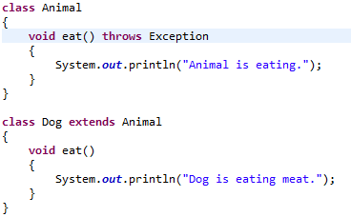
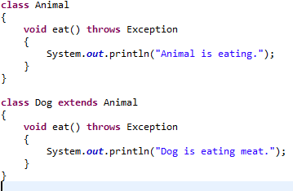
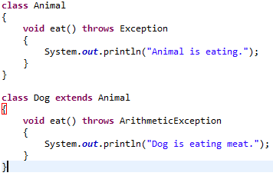

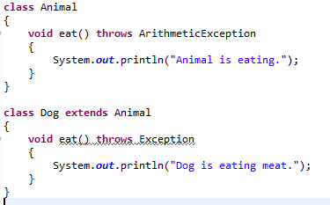

Exception Handling with Method Overriding
If the superclass method declares an exception:
If the superclass method declares an exception, subclass overridden method can declare same, subclass exception or no exception but cannot declare parent exception.

